Slide 1

Depression Analysis and Prediction
Submited By,
Navaneethakrishnan G
[ 7229-2021 DA Batch – Chennai EXL ]

Slide 2
Motivation
Depression is a common illness worldwide, with an estimated 3.8% of the population affected ,including 5% among adults and 5.7% adults older than 60 years.
Approximately 280 million people in the world have depression.
Depression may become a serious health condition. It can cause the affected person to suffer greatly and function poorly at work, at school and in the family. At its worst, depression can lead to suicide.
Over 7 lakh people die due to suicide every year. Suicide is the fourth leading cause of death in 15-29 year olds.
In this project we can find out the people who come under the most depressed category.

Slide 3









Objectives
Exploratory Data Analysis
Getting data
Cleaning data
Analysis
Visualization
Website
Data splitting
Model Training
Classification
Testing
Machine Learning

Slide 4
Getting & Cleaning Data
The original Dataset is taken from Kaggle website it was published by Frankcc
The dataset is involved into the analysis of depression.
The data was consists as a study about the life conditions of people who live in rural zones.
We cannot take all columns from the Dataset Because all the columns were not explicated in this challenge so We can´t understand them.
We proceeded to delete them or ignoring
Fill the NA values with using ffill method

Slide 5
Exploratory Data Analysis
With EDA(Exploratory Data Analysis) we can able to understand our data better way.
In here we can find out how the data was distributed ,shape of data, relationship between variables.
The libraries used for EDA Pandas, Seaborn, Matplotlib.

Slide 6
Machine Learning
For the classification purpose we can generate dummies for our data.
In here I use Gradient Boosting Algorithm to predict the data.
It’s also a machine learning technique which produces a prediction model in the form of an ensemble of weak prediction of weak prediction models, typically decision trees.
By using the CV method we find the max performance of the model.
The final model deployed with
Learning rate = 0.3
Max depth = 10
Max features = 0.2
Min sample leaf = 60

Slide 7
Implement in Website
Tools Requirement:
IDE : Visual Studio Code
Languages :
Front End:
Structure : HTML5
Style : CSS
Backend:
Python

Slide 8

Visualization

Slide 9
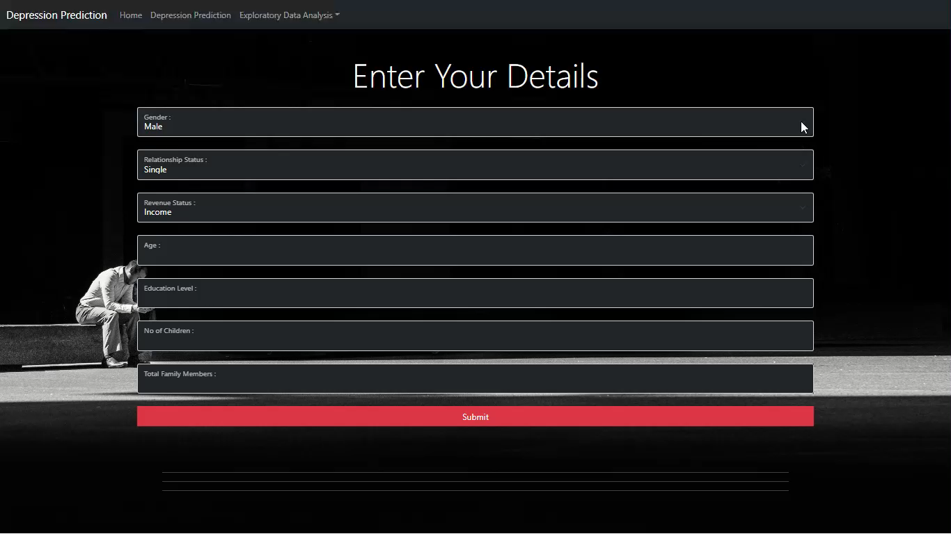
Depression Prediction

Slide 10
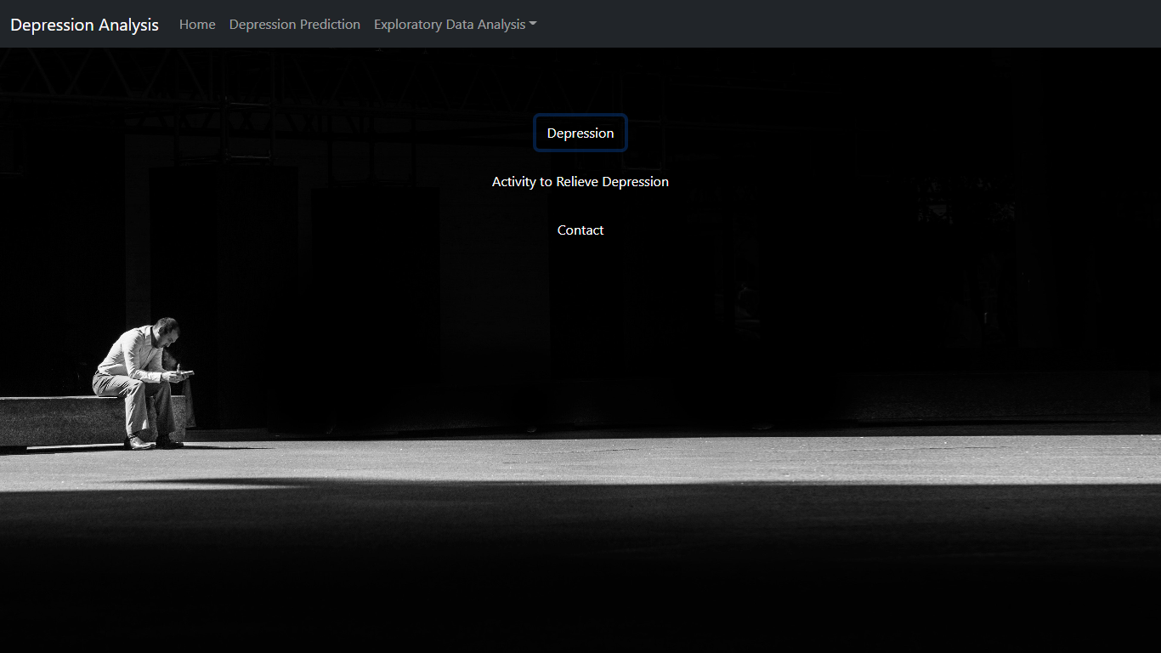
Website goto website

Slide 11
Any Questions?

Slide 12
Thank you!

